Slide 1
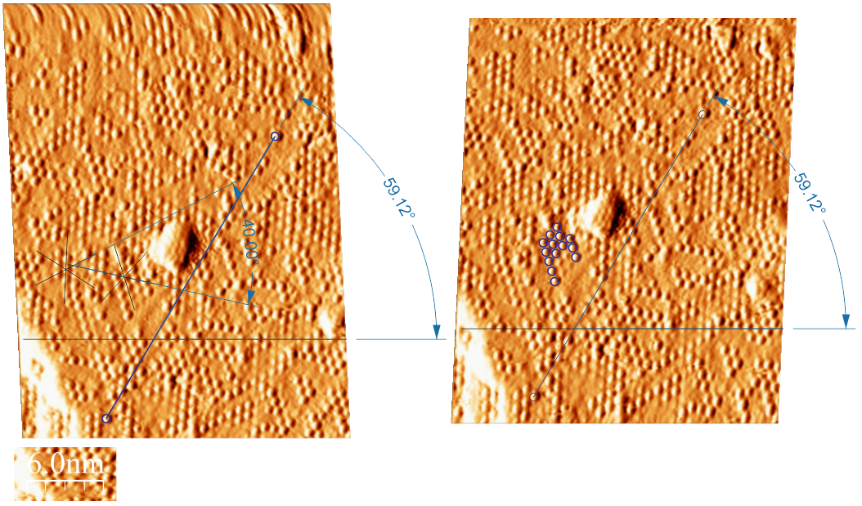
Image 32
Image 33

Slide 2
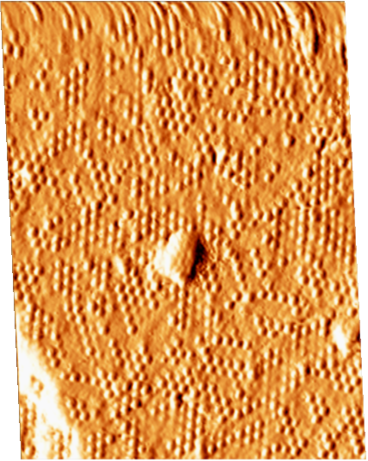
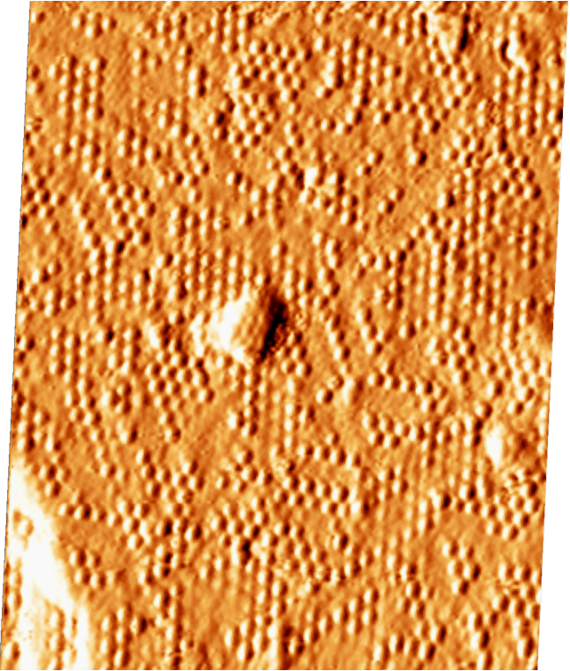
Image 32
Image 33

Slide 3
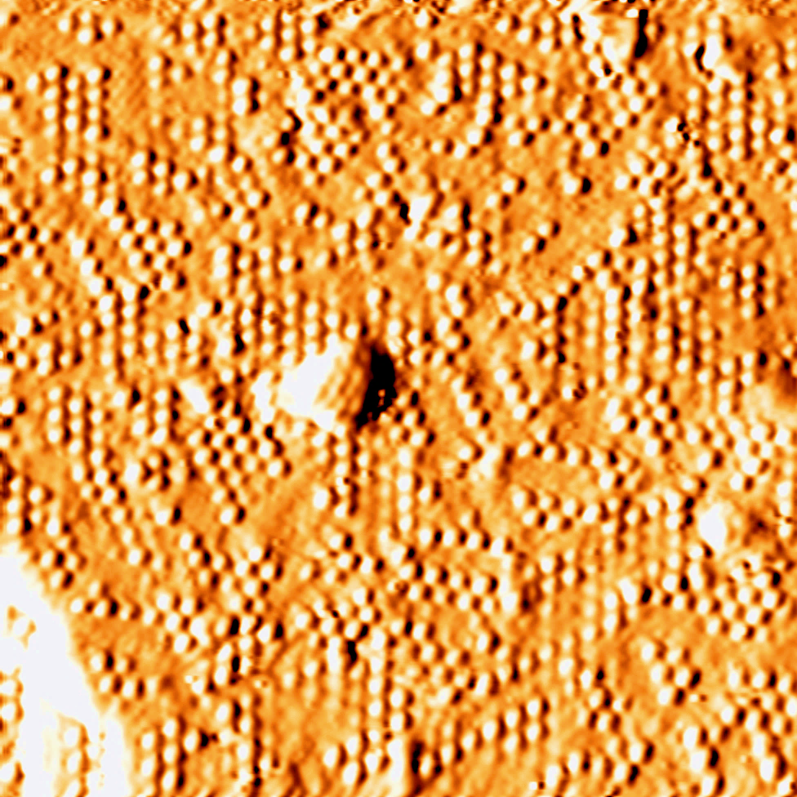
Image 33 Uncorrected
Image 33 Corrected

Slide 4
Image 33 Uncorrected
Image 33 Corrected

Slide 6
Normal Red
Normal Blue
Could be either a Red or Blue or both (or maybe a distortion)
Red Atoms too close
Blue Atoms too close
Potential Blue atoms (spots not bright – bumps instead).
Potential Red atom (same as above).

Slide 7
Picture removed

Slide 8
Only Blue atoms

Slide 9










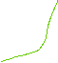

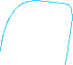

















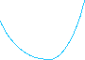









Blue atoms counted
Total Blue: 359
Total Potential Blue: 40
Total: 399
(Purple numbers is the total count of the dark blue dots. Reddish Pink is the count of the Potential blue dots (when the spot was not bright, but a bump was observed).

Slide 10
Only Red atoms

Slide 11
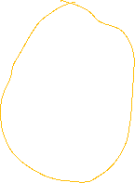
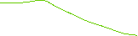

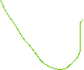






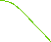
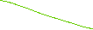




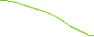





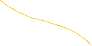






Red atoms counted:
Only Red: 325
Potential Red: 17
Total: 342

Slide 14
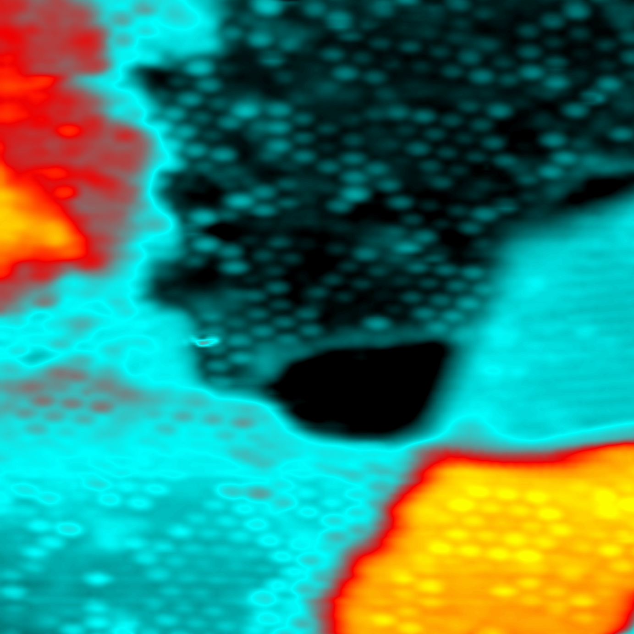
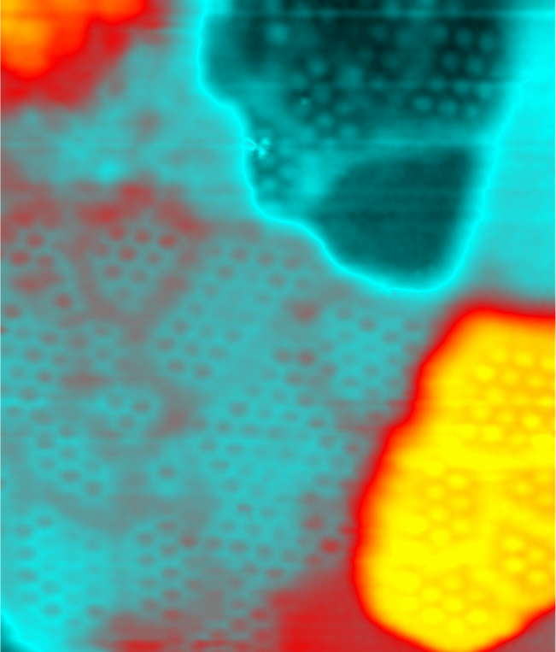

Slide 15
